Slide 1
GUI Modification after first demo
Bohan Wu
Aug 12, 2019

Slide 2
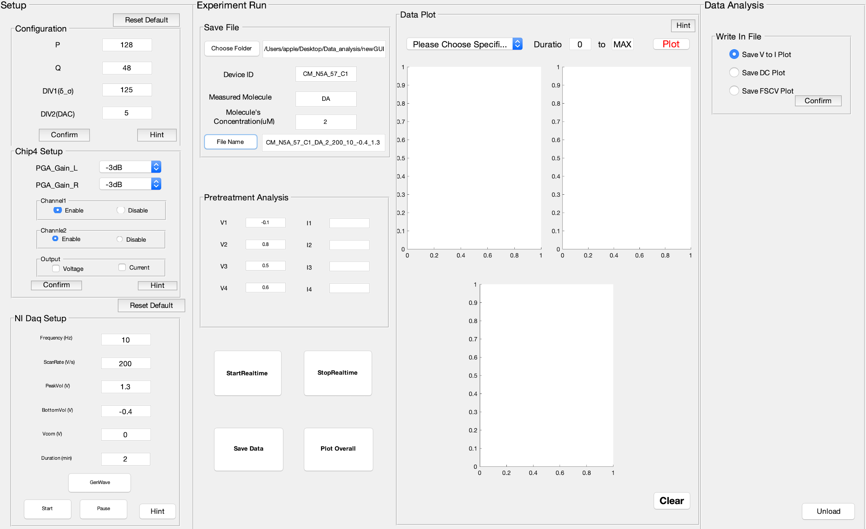
Chip4 Setup Modification
This version removed ‘ADC’, ‘TIA’, ‘Bias’ pop-up menu, and replaced them with two Enable-Disable panel.
User could easily click the radio button to enable specific channel they want
The version also added the ‘output’ panel, users could choose voltage or current, or both to see the output measurements.

Slide 3
NI DAQ Control modification
This GUI version change the way that how NI DAQ generates the triangular ramp signal.
Instead of having an specific duration of time, this version support user to start, pause and continue the triangular ramp signal at whenever they want by only clicking the pause and start button.

Slide 4
Save file implementation
This version also has more flexibility for saving data by choosing save path and changing file name.
Clicking ‘Choose Folder’ button, file explorer will pop up, user can choose which folder in which they want to save data. Also, the path will be shown on GUI.
By typing in the Device ID, measured molecules, and the concentration etc. (usually default value will be shown in the box, so user has no need to type in case they want to change it), then click ‘File Name’ button, the file name will be on the GUI.
Also, those data files will be generated automatically with certain names in certain folder after each measurement.

Slide 5
Save File implementation
The generated file name now including:
Device ID
Measured Molecule
Molecule’s Concentration
Scan Rate
Frequency
Upper and lower limits of the input voltage
I didn’t include the date because after the file is generated, those information will automatically shown in the file explorer. *Please let me know your suggestions. Thanks so much!

Slide 6
Conclusion
New Gui is available for user to directly enable and disable each channel.
New Gui is available for user to choose which output data they want. For example, voltage, current, or both.
New Gui is available for user to start and pause the input ramp signal randomly rather than a certain duration.
New Gui is available for user to choose where they want to save the data files.
New Gui is able to generate a comprehensive file name by given values. Also user has flexibility to change the file name.

